Slide 1
Case Study
MAIERATO, ITALY
LANDSLIDE (2010)
Group 6:
SCOTT SNOW
LUCY ASTORGA
MATT SAGUIBO

Slide 2
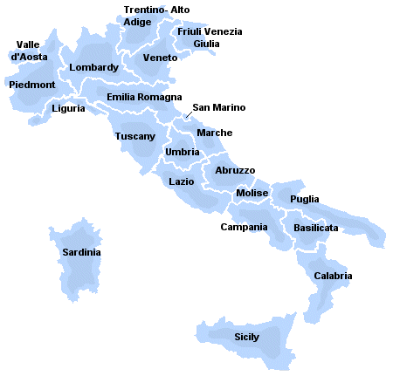
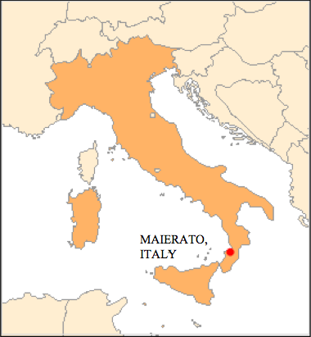
Site Background: Location
Southern Italy
Calabria Region

Slide 3
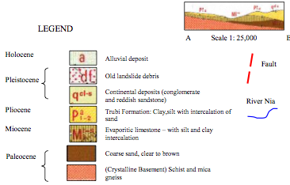
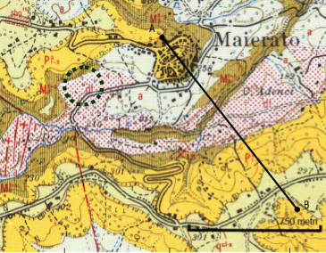
Site Background: Soil
From the bottom up…
Schist and mica-gneiss
Coarse sand/sandstone
Evaporitic limestone
Claysilt with sand

Slide 4
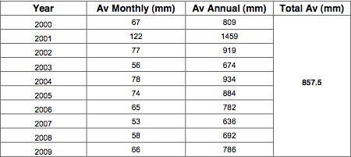
Site Background: Climate
Mild winters and temperature changes
Rarely severe rainfall
Two wet seasons
Saturated soils

Slide 5
Problem Description
https://www.youtube.com/watch?v=-nx-gYYRu5I

Slide 6
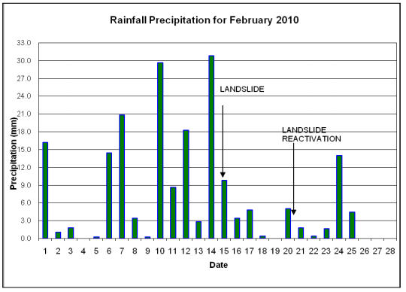
Problem Description
Mechanism of Slope Failure:
Vertical Infiltration Process
Seepage flow along base rock
Water Table exceeded limit level

Slide 7
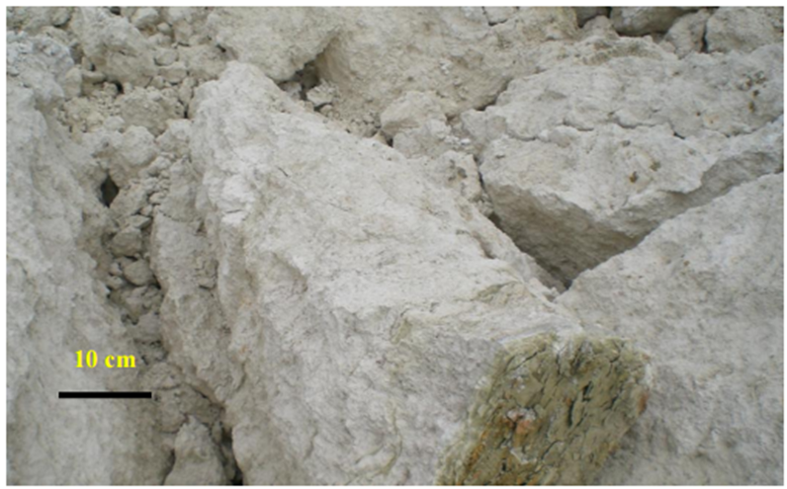
Problem Description

Slide 8
Failure Slope Video
https://www.youtube.com/watch?v=vJtYTbQecNE

Slide 9
Aftermath of the Landslide
Notes:
The Maierato landside was considered a complex and composite roto-translational rock slide.
The landslide was a geological phenomenon caused by heavy rainfall.
This cause the pore water pressure along with gravity to be the main triggering mechanism for this landslide.

Slide 10
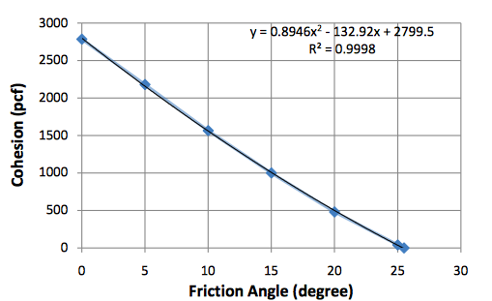
Slope Stability Analysis
The cohesion (c) and friction angle ()
Create Linear Relationship between "Normal Force" (i.e. pressure from weight perpendicular to the failure surface) and shear strength (i.e. resistance to sliding-shearing along the failure surface)
Trying to achieve a FS =1
Factor of Safety (FS) is defined as the resisting stresses dividing by the driving stresses
Slope failure occurs when
resisting stresses = the driving stress
Notes:
Linear develop of the cohesion- friction angle representative of the sliding surface in Maierato.

Slide 11
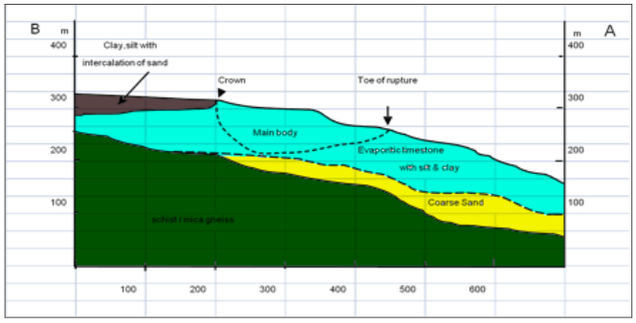
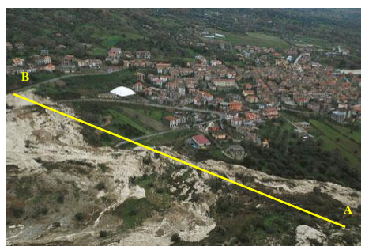
Slope Stability Analysis
Computer Program:
GSTABL7 Version 2.0
Purpose:
Calculate the mobilized shear strength at failure
Assumptions:
Failure surface = circular
Slope profile determined using topographic map
Water depth = 20 ft below surface
Soil properties estimated within the normal ranges

Slide 12
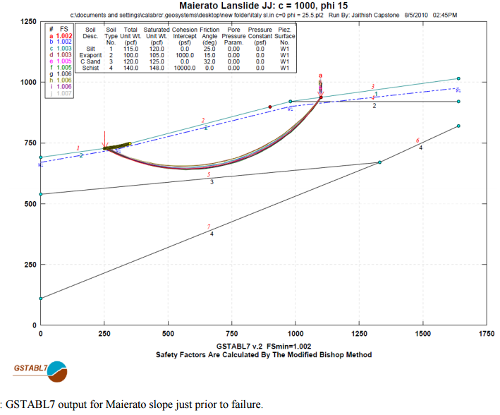
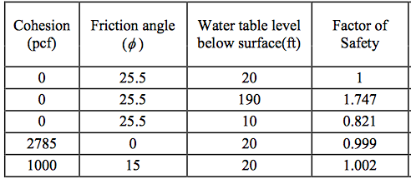
Slope Stability Analysis Results
Notes:
C = 2785 is a soil that is perfectly cohesive
cohesion can’t be less than 0
Phi = 25.5 perfectly frictionless
good idea of phi compared to similar cases/materials
Changed the water table to see the stability of the slope.
The rain contributed to the reduction of the cohesive component of soil shear resistance

